Slide 1
Security for What Matters Most: Data & Identities
Notes:
[Insert your own intro here depending on your audience]

Slide 2
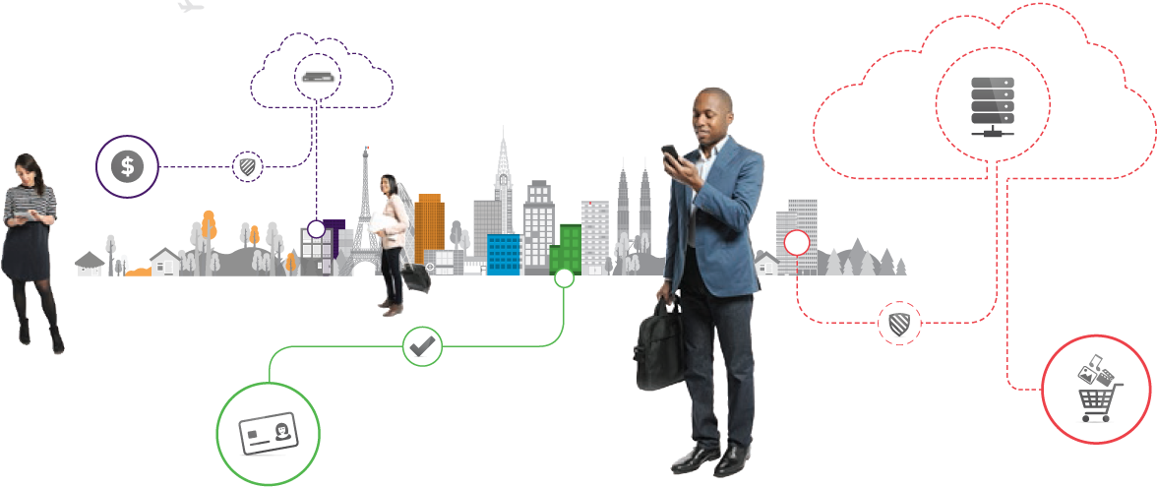
The digital world is transforming the way your enterprise works
35%
AMOUNT OF ALL CORPORATE
DATA STORED
IN THE
CLOUD²
23.6bn
NUMBER OF CONNECTED DEVICES
BY 2020³
90%
AMOUNT OF THE WORLD’S DATA CREATED IN
LAST TWO
YEARS¹
¹ IBM
² Ponemon Institute
³ Cisco Visual Networking Index
Notes:
The digital world is transforming every aspect of our daily lives, and that includes the way we work. To compete, today’s enterprises are embracing:
the simplicity and ease of the cloud and SaaS applications
the convenience of mobility and bring your own device
increased insights from connected devices and the Internet of Things
As well as the need to mine more value from more information with big data and analytics platforms.
These are just a few of the emerging technologies that are helping to move business forward…faster.

Slide 3

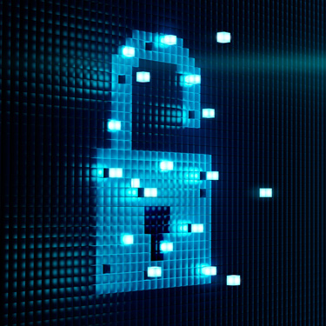



Security solutions must align with current and future business needs
More data produced, stored, & shared
More advanced threats
More compliance & regulatory mandates
More networks, clouds, & devices
More risk of human error
Notes:
But it’s not just businesses that are finding value in data…hackers are too.
And that’s why it’s important to continue to adapt your security strategy to align with the way your business works, particularly as you…
Produce, store and share more data in more places.
Manage more networks, clouds, and devices accessing your corporate resources.
Face more advanced threats as your attack surface sprawls.
Navigate the requirements of more complex compliance and regulatory mandates, such as GDPR and PCI-DSS.
And, finally, work to reduce human error as teams grow to manage all of this…

Slide 4
Would your data be secure after a breach?
The Perception
The
Reality
94%
65%
94%
of enterprises aren’t confident their data would be secure after a breach.
of enterprises say their perimeter security technology is quite effective at keeping unauthorized users out of their networks.
Source: 2017 Gemalto Data Security Confidence Index report
Notes:
To address these challenges, we know that many enterprises have deployed perimeter security.
According to our latest research, 94% of enterprises believe their perimeter security is effective at keeping unauthorized users out of their network.
However, we also found that 65% aren’t confident their data would be secure in the event of a breach.
That’s quite a disconnect.
So the question becomes, if your business is breached today, would your data be secure?

Slide 5


Attacks are overcoming traditional security methods every minute
1,378,509,261
Records exposed in 2016
As a result of
1,792
data breaches globally
Number of records
compromised
EVERY DAY
EVERY HOUR
EVERY MINUTE
EVERY SECOND
3,776,738
157,364
2,623
44
More than 95% of all data breaches involved data that was NOT ENCRYPTED
Source: 2016 Breach Level Index
Notes:
Let’s take a look at what’s happening in the market.
We know that businesses of every size…in every industry…and in every corner of the globe, have been impacted by data breaches.
In fact, more than 1.3 BILLION data records were lost or exposed as a result of data breaches in 2016 – that’s more than 3.7 million records each day.
It’s also important to note, that while these businesses may have deployed perimeter security, more than 95% of the breaches involved data that was not encrypted.

Slide 6
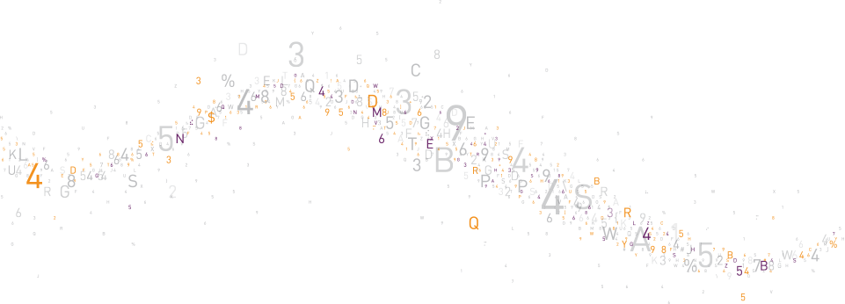
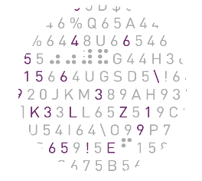


With no defined perimeter in the digital world, it’s time for a fundamental shift in the security paradigm…
…by moving security closer to what matters most – Data and Identities
Notes:
That’s why it’s time for a new mindset when it comes to data security.
You need to assume you will be breached and think beyond the perimeter to move security closer to what matters most to your business – data and user identities.

Slide 7



What if you could centralize security across your enterprise – at the edge and the core?
PROTECT
DATA ACROSS
NETWORKS AND
THE CLOUD
SECURE
ACCESS AND
DEVICES
Notes:
Imagine for a moment that you could centrally manage and control user access at the edge, while applying security directly to your data at the core.
It’s possible.
Let’s talk about what that means and how to build a secure breach strategy that’s designed to keep your data secure wherever it goes.

Slide 8
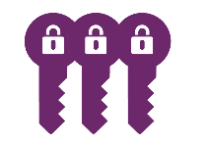

Move security beyond the perimeter to defend what’s really under attack
OWN & SECURE ENCRYPTION KEYS
Manage key lifecycle
Store keys securely
Manage cryptographic resources
ENCRYPT SENSITIVE DATA
Secure data at rest and data in motion
Secure data across cloud, virtual, and on-premises environments
CONTROL ACCESS
Manage and ensure appropriate access to resources across enterprise environments
Provide strong multi-factor authentication to corporate resources
Notes:
[Note: Slide is animated to build]
When you extend your security strategy beyond the perimeter, you can defend what’s really under attack.
A secure breach strategy is comprised of three steps or tactics:
First, you’ll need to protect your sensitive data, regardless of where it flows or resides. To do this, determine where your most sensitive assets are located across your on-premises, cloud, and virtual environments. Search your file servers, applications, databases, and virtual machines for data at rest that must to be protected. And, don’t forget to consider the network traffic flowing between your physical offices or other offsite locations. Once this data leaves the confines of your organization, you lose control over it. Attackers are ready to ‘tap’ the fiber optic cables, and human error can result in data transmission to the wrong location. Once you’ve located your sensitive data, encrypt it. Encryption is the critical last line of defense in the event of a breach because it applies protection and controls directly to your data. It ensures your data remains secure wherever it goes and renders it useless to attackers.
The next step in your secure breach strategy is to centrally and securely manage and store your encryption keys. As the amount of data that you need to encrypt grows, so will the number of encryption keys. If you attempt to manage these keys in siloes, it can leave them vulnerable to theft and misuse – especially if they are stored with the encrypted data or managed by a third party, such as a cloud service provider. Enterprise key management provides a foundation for deploying encryption across your distributed organization. It enables you to centralize the management of important tasks including secure key generation, storage, rotation, back-up, and deletion. You also have the ability to define and control access to your protected information, ensuring you maintain complete ownership and control of your protected data and keys at all times. For an added layer of high-assurance security, you should consider storing your keys in a hardware security module (HSM). An HSM is a trust anchor that can securely manage, process, and store your cryptographic keys.
Good encryption and key management will safeguard your sensitive data, but you also need to control who can access it. As your enterprise adopts new technologies such as mobile and cloud applications, increased controls are necessary. After all, relying on a simple user name and password is not an adequate method for protecting you, your company, your data, or your customers. The final step of your secure breach strategy is to control and manage access to your corporate resources. Access management enables you to verify a user’s identity, assess and apply the appropriate access policy, and enforce the correct access controls using single sign on.

Slide 9

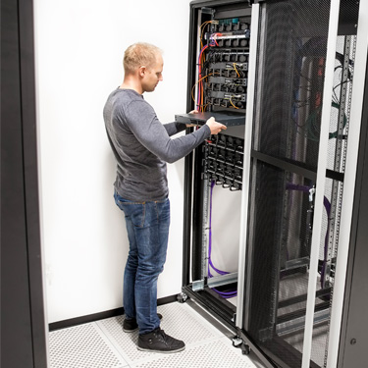

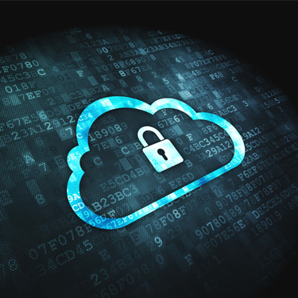



Overcome your complex data security challenges
Gain portability and control
Reduce
costs
Ease compliance
Centrally manage access and secure data & identities
Eliminate islands of security
Define unified security policies
Notes:
And when you execute a secure breach strategy, you not only protect your data in the event of an attack, you can address many of the other security challenges you face across your organization, including the need to:
Centrally manage access to corporate resources, as well as the security of data and user identities
Gain portability and control
Eliminate islands of security
Reduce IT costs
Define unified security policies
And ease and meet compliance and regulatory mandates

Slide 10









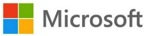











Secure your digital transformation with Gemalto
OUR CUSTOMERS:
Large enterprises
Financial services
Governments
Healthcare organizations
Retailers
Cloud service providers
Internet of Things
The Enterprise
Compliance
Cloud
SECURITY FOR:
Internet of Things
Big Data
Digital Payments
& Transactions
Cloud Access Management & SSO
Encryption & Enterprise Key Management
SOLUTIONS:
Multi-factor Authentication
High Assurance Key Protection
Notes:
As the world leader in digital security, Gemalto can ensure the authenticity of your banking transactions, safeguard your health records, protect the purchase of your morning cup of coffee, and help you control risk, manage security, and maintain compliance.
Regardless of the industry you’re in or the current IT projects or priorities of your business, we offer a deep portfolio of proven identity and data protection solutions designed to secure the digital transformation of your business.

Slide 11
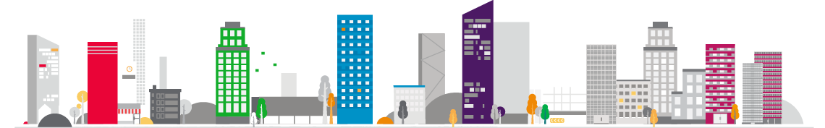
We provide trusted security for today’s industry leaders
5 of the world’s largest healthcare providers
14 of the world’s largest banks
5 of the world’s largest cloud service providers
10 of the world’s largest software companies
12 of the world’s largest manufacturing companies
8 of the world’s largest retailers
Notes:
In fact, our portfolio of SafeNet Identity and Data Protection solutions are trusted by the largest and most respected brands around the world to protect their data, identities, and intellectual property, including:
8 of the world’s largest retailers
14 of the world’s largest banks
5 of the world’s largest healthcare providers
5 of the world’s largest cloud service providers
10 of the world’s largest software companies
And 12 of the world’s largest manufacturing companies

Slide 12


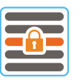
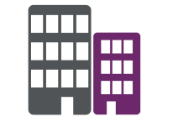





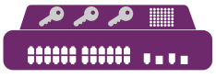
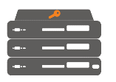

Security delivered the way you want it
PROTECT ANYTHING
Digital Payments &
Transactions
Compliance
Big Data
Enterprise
Security
Internet of
Things
Cloud
On Demand
Cloud-based | as-a-Service
CONSUMPTION MODELS
Hybrid
On-Premises
Hardware or Software
ENCRYPTION
KEY MANAGEMENT
AND PROTECTION
IDENTITY AND ACCESS
MANAGEMENT
UNIFIED DATA SECURITY SOLUTIONS
Data-at-rest encryption
Data-in-motion encryption
Enterprise key lifecycle management
High assurance key protection
HSM orchestration and crypto operations
Access management
Multi-factor authentication
PKI credential management
Notes:
We’ve become a trusted leader by specializing in delivering security the way you want it.
Our portfolio of encryption, key management and protection, and identity and access management solutions provide centralized, enterprise-ready identity and data protection across on-premises, cloud, and hybrid environments.
These solutions complement the IT and security plans you already have in place and are available to be deployed on-premises across all of your environments, or on demand from the cloud.

Slide 13
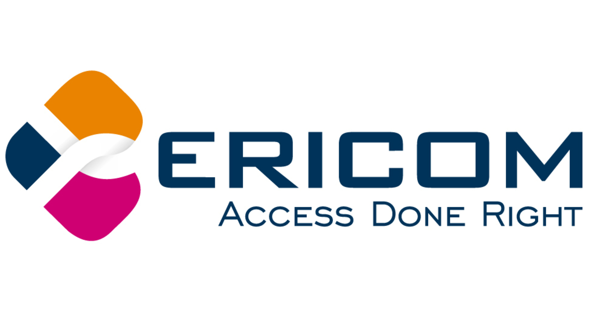
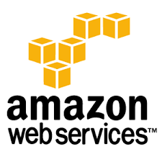


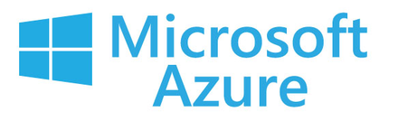


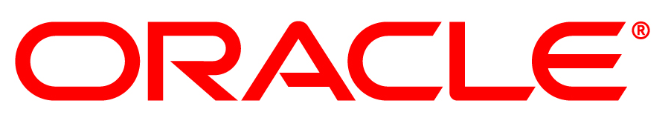

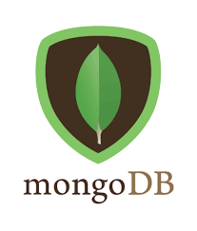
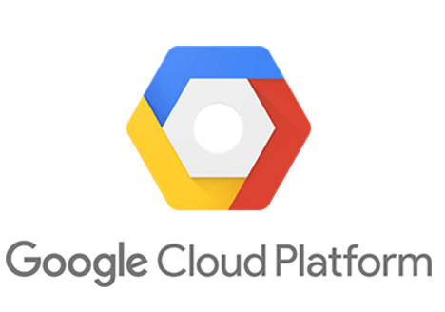
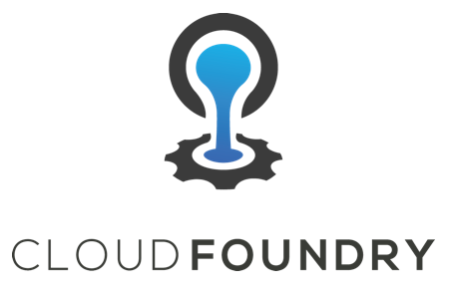

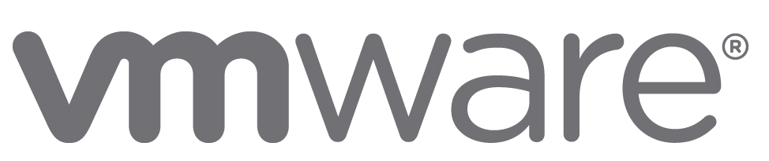
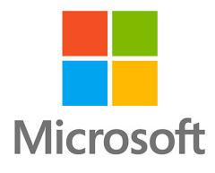

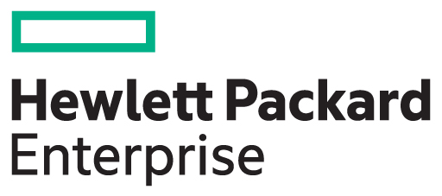


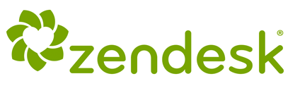
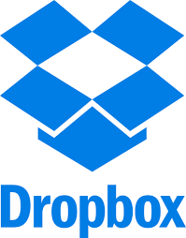
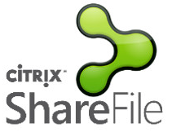

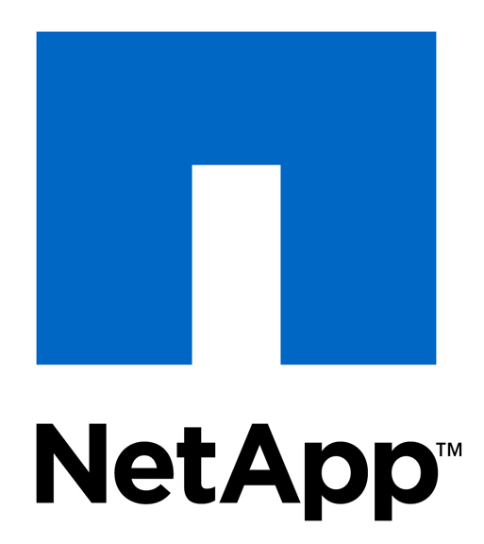


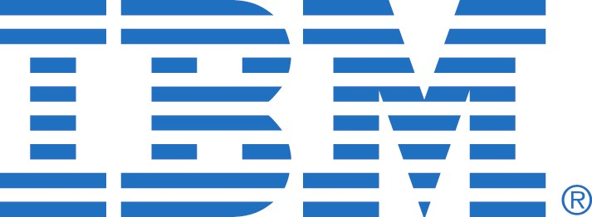
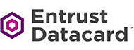

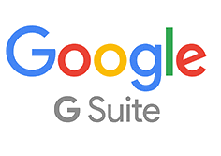

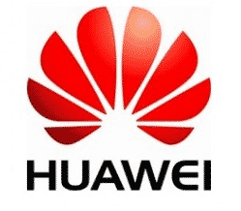


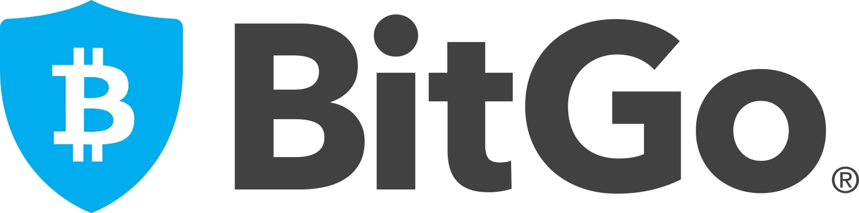

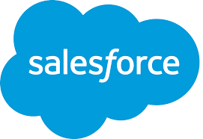

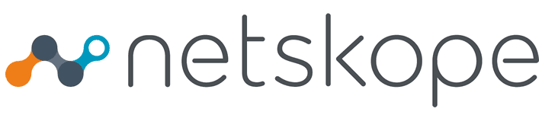
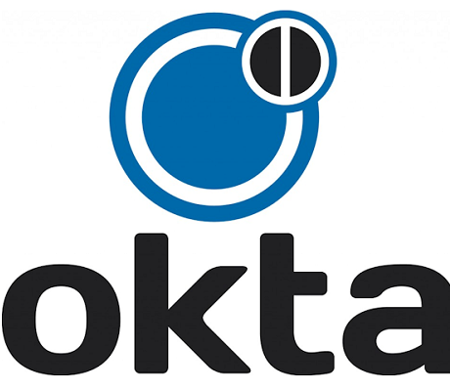

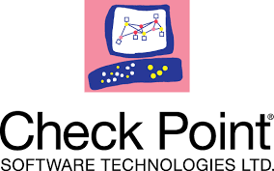
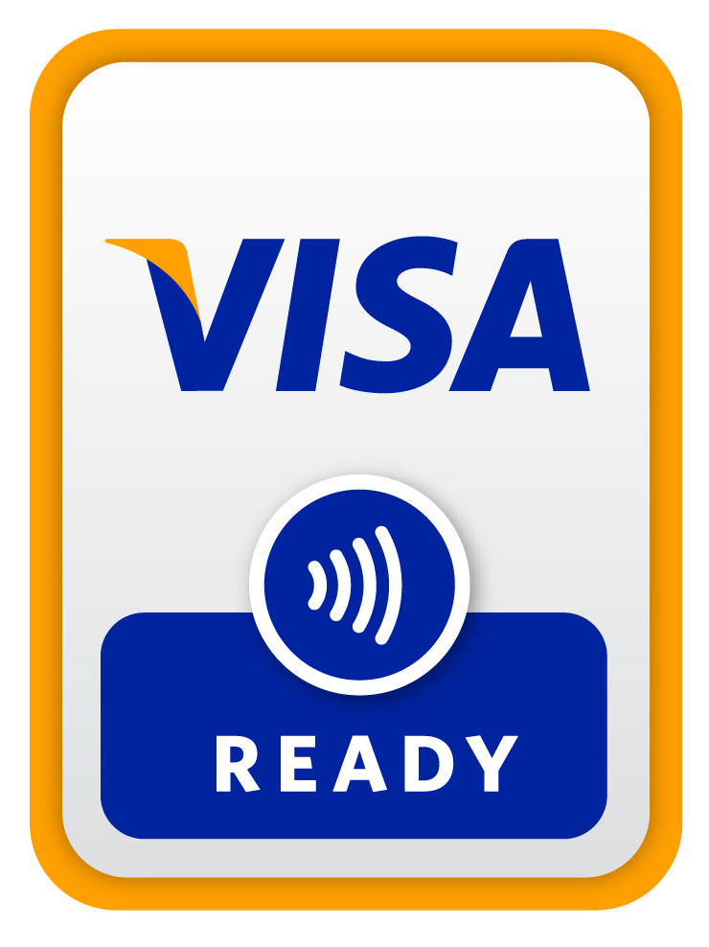

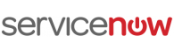
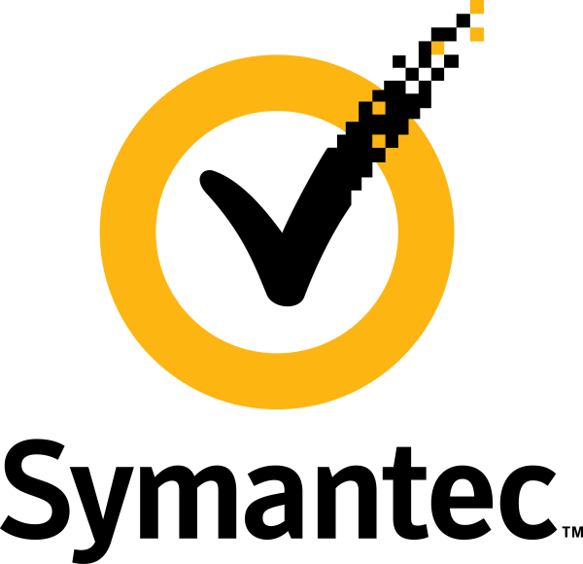

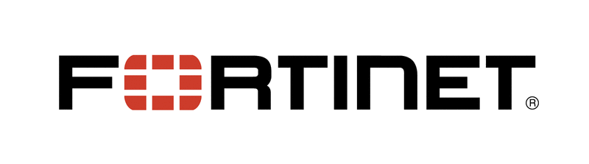


Integrated with the technologies you use everyday
CLOUD & SAAS APPS
IAAS & PAAS
VDI ACCESS
BIG DATA
STORAGE
DIGITAL SIGNING
BLOCKCHAIN
VPN ACCESS
END POINT PROTECTION
INTERNET OF THINGS
*Not a complete list of available integrations. Please contact us for more information.
Notes:
And, because our solutions integrate with a growing ecosystem of today’s leading technologies, you can scale security to meet both the current and future needs of your business.
It’s important to note here that this is not a complete list of our available integrations. Be sure to connect with [me/your Gemalto representative] to discuss any specific integrations or use cases.

Slide 14
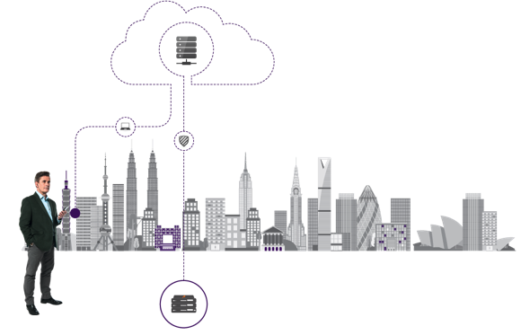

SafeNet Data Protection Solutions
Key Management & Crypto Operations
Encryption
SafeNet KeySecure
Centralized key lifecycle management
SafeNet Virtual KeySecure
Centralized key lifecycle management available as a hardened virtual appliance
SafeNet Luna HSM
High assurance key protection
SafeNet Payment HSM
Hardware security module for financial transactions
SafeNet ProtectServer
Hardware security module for server & web apps
SafeNet CryptoCommand Center
Hardware security module orchestration
SafeNet ProtectV
Full disk encryption for VMs/cloud instances/bare metal servers
SafeNet ProtectFile
File system-level encryption
SafeNet ProtectApp
Application-level encryption
SafeNet ProtectDB
Column-level encryption
SafeNet Tokenization
Application-level tokenization
SafeNet High Speed Encryptors
High-assurance certified Layer 2 encryption
ON-PREMISES
Hardware & Software
SafeNet Data Protection On Demand
ON DEMAND
Cloud-based
SafeNet HSM On Demand
Cryptographic key generation, storage, and management
SafeNet Key Management On Demand (Coming soon)
KMIP and key brokering services
Notes:
Now let’s take a quick look at our solutions. We’ll start with our SafeNet Data Protection portfolio that enables your organization to deploy centralized enterprise key management and encryption across distributed environments.
Our SafeNet encryption solutions work together with SafeNet KeySecure to enable enterprises to centrally secure sensitive data at every level of the stack – from clients and applications to databases and file storage. No matter where it resides…on-premises, in the cloud, or hybrid environments, our encryption and tokenization solutions can secure your sensitive structured or unstructured data at rest. And, when your data is moving between physical locations or to and from the cloud, our high speed encryption solutions will keep it safe in transit too.
With SafeNet KeySecure, you can centrally manage the entire key lifecycle – from key generation to storage and archival and termination - and, ultimately, manage and prove ownership of your data wherever it goes. This industry-leading enterprise key management platform is available as a hardware appliance or hardened virtual security appliance.
For an added level of security, SafeNet Hardware Security Modules provide a secure vault because the keys never leave the intrusion-resistant, tamper-evident, FIPS-validated hardware appliance. Since all cryptographic operations occur within the HSM, strong access controls prevent unauthorized users from accessing sensitive cryptographic material. Additionally, our HSMs integrate with SafeNet Crypto Command Center for quick and easy crypto resource partitioning, reporting and monitoring. And now, with the introduction of SafeNet Data Protection On Demand, enterprises can deploy solutions like SafeNet HSM OnDemand and Key Brokering services - all on demand from the cloud.

Slide 15





SafeNet Identity and Access Management Solutions
SafeNet Authentication Manager
SafeNet Authentication Client
SafeNet Authentication Service
SafeNet Trusted Access
High Assurance Authentication
Converged Badge
Digital Signing
Email Encryption
Pre-boot Authentication
Multi-factor
Authentication
Identity As A Service
Single Sign On
Access Management
Authentication as a Service
Context-based Authentication
CREDENTIAL MANAGEMENT
ACCESS MANAGEMENT
Notes:
To secure identities and control access to your data and applications, we offer a portfolio of industry-leading Access Management and PKI credentialing solutions. Both complement each other by addressing the widest range of use cases including Cloud SSO, secure remote access, network logon, converged badge solutions, email encryption and digital signing.
For access management we have SafeNet Trusted Access - a cloud based access management service that allows you to manage cloud access and offer SSO for cloud applications. The service includes all the capabilities offered by SafeNet Authentication Service, our award winning multi-factor authentication service, which offers multi-factor authentication for hundreds of enterprise applications.
Additional high-assurance enterprise use cases are supported by our suite of PKI credential management solutions which enable converged bade solutions, high-assurance remote access with PKI smartcards, digital signing and email encryption. Our PKI credentialing solutions comprise a completely integrated solution consisting of SafeNet Authentication Manager, a PKI management server, SafeNet Authentication Client, PKI middleware and a broad range of PKI-based smartcards and USB tokens.
As you can see we have a very broad IAM portfolio that can secure an organization’s cloud environment by managing access to cloud services and providing a seamless yet secure SSO experience, while at the same time ensuring that more sensitive applications can be secured with higher assurance PKI based solutions.

Slide 16
Thank you!
Notes:
I’ll wrap up this discussion today by asking you one question…
How confident are you that your data would be secure after a breach?
If you have any doubt, we’re here to help you build your secure breach strategy. We can work with you to demonstrate how and where our solutions fit into your existing IT and security projects and make sure you’re thinking beyond the perimeter to keep your data secure wherever it goes.

